Slide 1
How to Succeed in Crowdfunding: Setting a perfect goal
CS7930: Social Media Mining
Hongkyu Choi, Thanh Tran

Slide 2
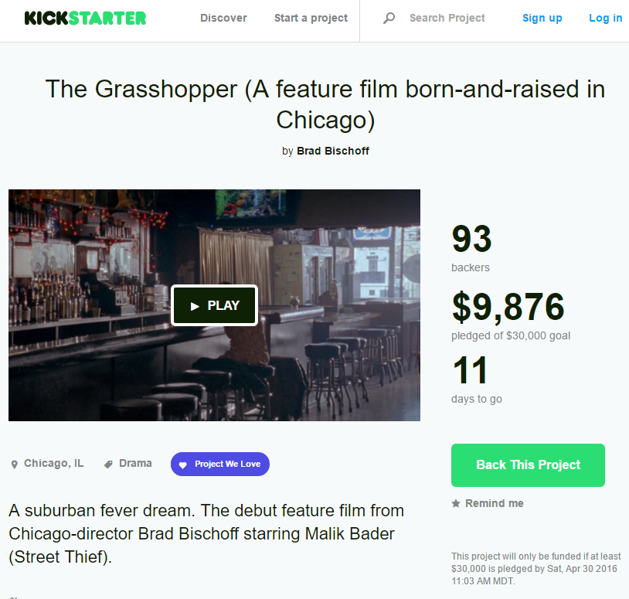
Kickstarter
All or nothing crowdfunding platform
Predicting the amount of money or the number of backers are very important for Kickstarter creators to raise fund
Description | #
# of Kickstarter Projects | 151,608
# of Kickstarter Users | 142,890
Notes:
Cleaned(Remain) dataset

Slide 3
Distinctions from Previous Work
Previous Work: Whether the project success or not / Recommend a user to proper project which he/she might be interested / Predict the range of pledged money(Dr. Lee’s work)
Our Work: Predict exactly the amount of pledged money + number of backers
Notes:
Understand the influence of multiple factors toward the number of backers and the amount of final pledged money that a certain project can receive. We will show statistic values to illustrate for such influence.
Given a project, we build a model to predict how much pledged fund the creator can receive.
Building a model to predict how many backers will fund for the project.

Slide 4
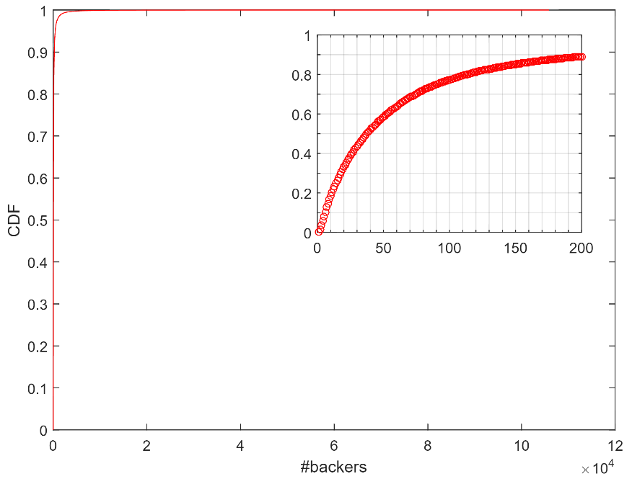
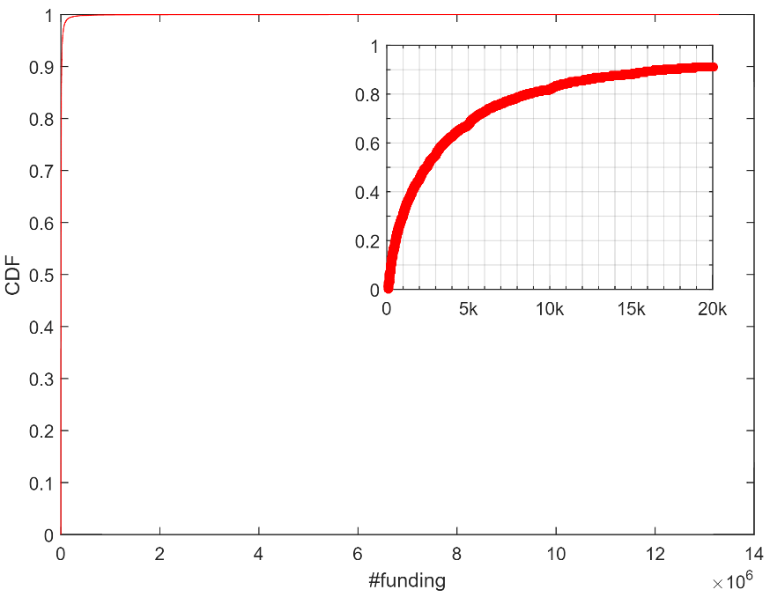
Distributions of # of Backers and Pledged Money

Slide 5
Features
The Number of Feature Extracted: 41
numProjectComments | numUpdates | cnumCreated
numUpdates | smogReward | cnumBioSentence
numRewards | numRewardSentences | cnumBacked(15 features)
numImages | numMainSentences | cnumCreatorComment
numVideos | smogMain
numFaqs | smogBio | cnumFbFriends
goal |  | ctwitterConnected
category | backedProjectSuccessfulRate | cfacebookConnected
fundRaisingDuration | previousProjectSuccessRate | cyoutubeConnected | cwebsiteCount
Notes:
Categorize

Slide 6
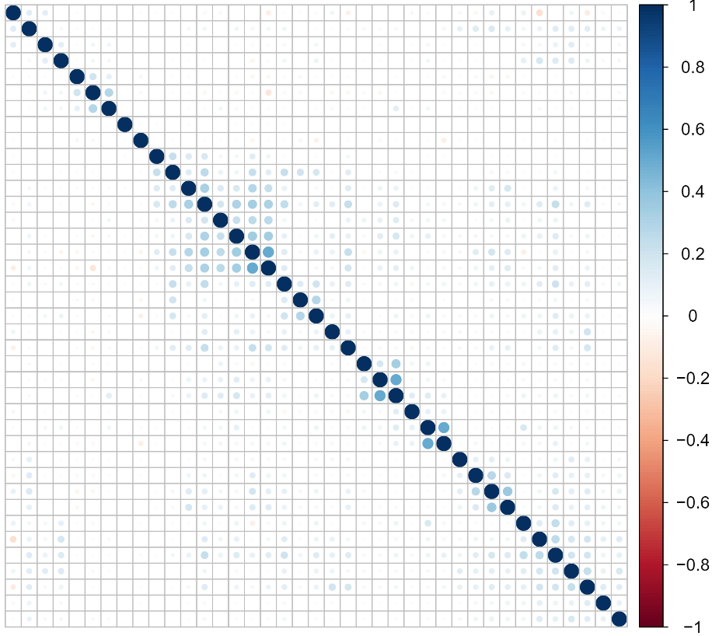
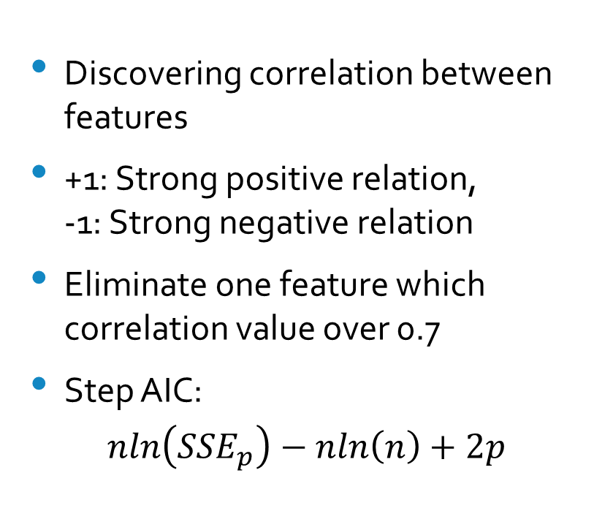
Feature Selection
Discovering correlation between features
+1: Strong positive relation, -1: Strong negative relation
Eliminate one feature which correlation value over 0.7
Step AIC:
$$nln\left({SSE}_{p}\right)−nln\left(n\right)+2p$$

Slide 7

Evaluation Measurement
$$RMSE= \sqrt{\sum_{i=1}^{n}{\frac{{\left(Y_{i}−{\hat{Y}}_{i}\right)}^{2}}{n}}}$$
Notes:
RMSE(Root-mean-square Error): measure of the differences between values (sample and population values) predicted by a model and the values actually observed
These individual differences are called residuals when the calculations are performed over the data sample that was used for estimation, and are called prediction errors when computed out-of-sample

Slide 8
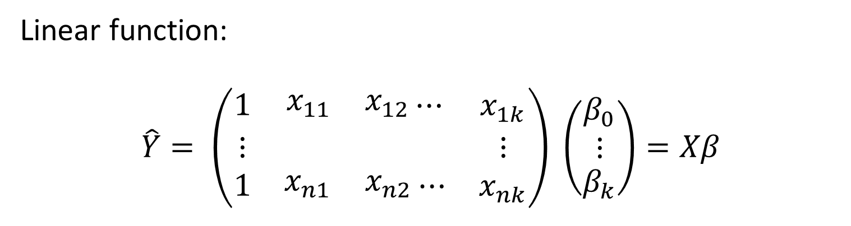
Linear Regression Model
Linear function:
$$\hat{Y}= \left(\begin{matrix}1 & \begin{matrix}x_{11} & x_{12}\end{matrix}⋯ & x_{1k} \\ ⋮ & & ⋮ \\ 1 & \begin{matrix}x_{n1} & x_{n2}\end{matrix}⋯ & x_{nk}\end{matrix}\right) \left(\begin{aligned}\begin{matrix}β_{0} \\ ⋮\end{matrix} \\ β_{k}\end{aligned}\right)=Xβ$$
Model | # of Backers | # of Funding
Linear Regression | 66.9 | $5,320

Slide 9
Boosting Regression Model
Using Multiple Linear Regression
Model | # of Backers | # of Funding
Linear Regression | 66.9 | $5,320
Boost | 28.7 | $2,121
Notes:
Adding Animation

Slide 10
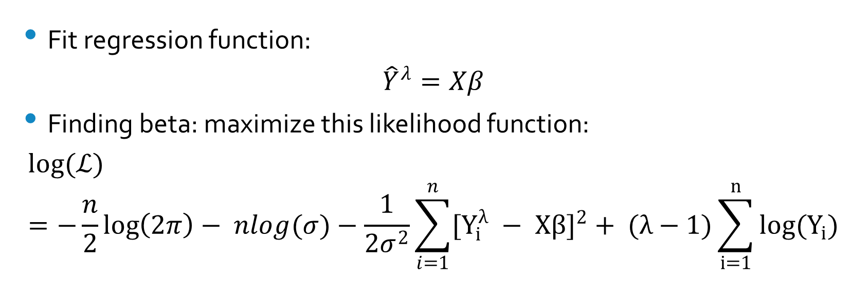
Our Model - Non Linear Model
Fit regression function:
$${\hat{Y}}^{λ}=Xβ$$
Finding beta: maximize this likelihood function:
$$log(ℒ)=−\frac{n}{2}\log\left(2π\right)− nlog(σ)−\frac{1}{2σ^{2}}\sum_{i=1}^{n}{{[Y_{i}^{λ} − Xβ]}^{2}}+ (λ−1)\sum_{i=1}^{n}{log(Y_{i})}$$

Slide 11
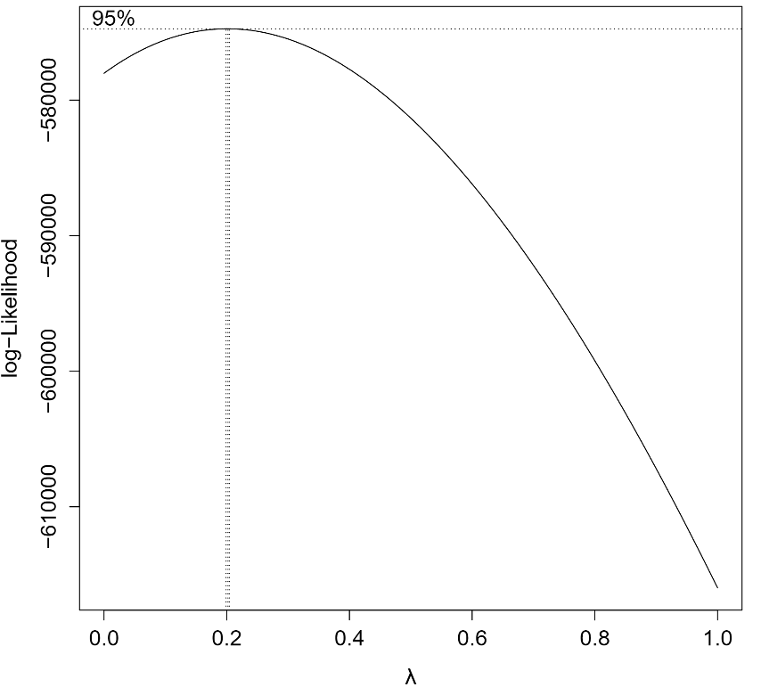
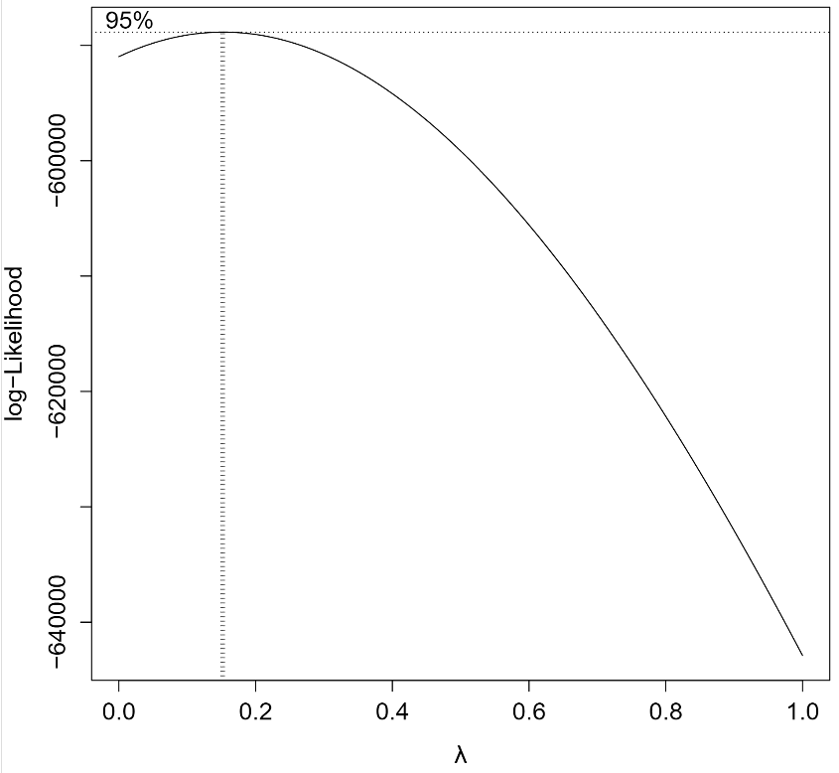
Finding Lambda Values
Backer: λ=0.2
Funding: λ=0.15

Slide 12
Final Results

Slide 13
Coefficient of Features
Significant Features with Coefficient
* < 0.05, **<0.01, ***<0.001
Feature Name | Coefficient | Feature Name | Coefficient | Feature Name | Coefficient | Feature Name | Coefficient
numProjectComments *** | 23539.09 | smogMain *** | 341.549 | cnumBioSentence *** | 141.075 | cfacebookConnected *** | -643.742
numUpdates *** | 2816.502 | numMainSentences *** | 335.187 | numFaqs *** | 134.553 | cbackedCategories *** | -697.825
cnumFbFriends *** | 1002.85 | Category *** | 293.621 | cbackedCategories * | 89.731 | cbackedCategories *** | -847.89
numRewards *** | 951.701 | cbackedCategories *** | 291.544 | numImages *** | 27.47 | cnumCreated *** | -1915.6
Goal *** | 800.64 | cbackedCategories *** | 264.193 | cbackedCategories *** | 13.272
previousProjectSuccessRate *** | 779.975 | cnumCreatorComment * | 246.34 | cwebsiteCount *** | 7.455
numVideos *** | 594.218 | cbackedCategories *** | 240.012 | ctwitterConnected *** | -0.5
smogBio *** | 444.779 | cbackedCategories *** | 230.262 | cbackedCategories ** | -61.033
cbackedCategories *** | 429.861 | cbackedCategories *** | 202.355 | cyoutubeConnected *** | -183.622
backedProjectSuccessfulRate *** | 428.13 | cbackedCategories *** | 158.055 | cbackedCategories ** | -249.037
Notes:
Explain Normalized(0-1), Funding based coefficient

Slide 14
Q & A

